Slide 1

Topic: First Law of Thermodynamics
Lecture - 3
Disclaimer:
The study materials/presentations are solely meant for academic purposes and they can be reused, reproduced, modified, and distributed by others for academic purposes only with proper acknowledgements.

Slide 2
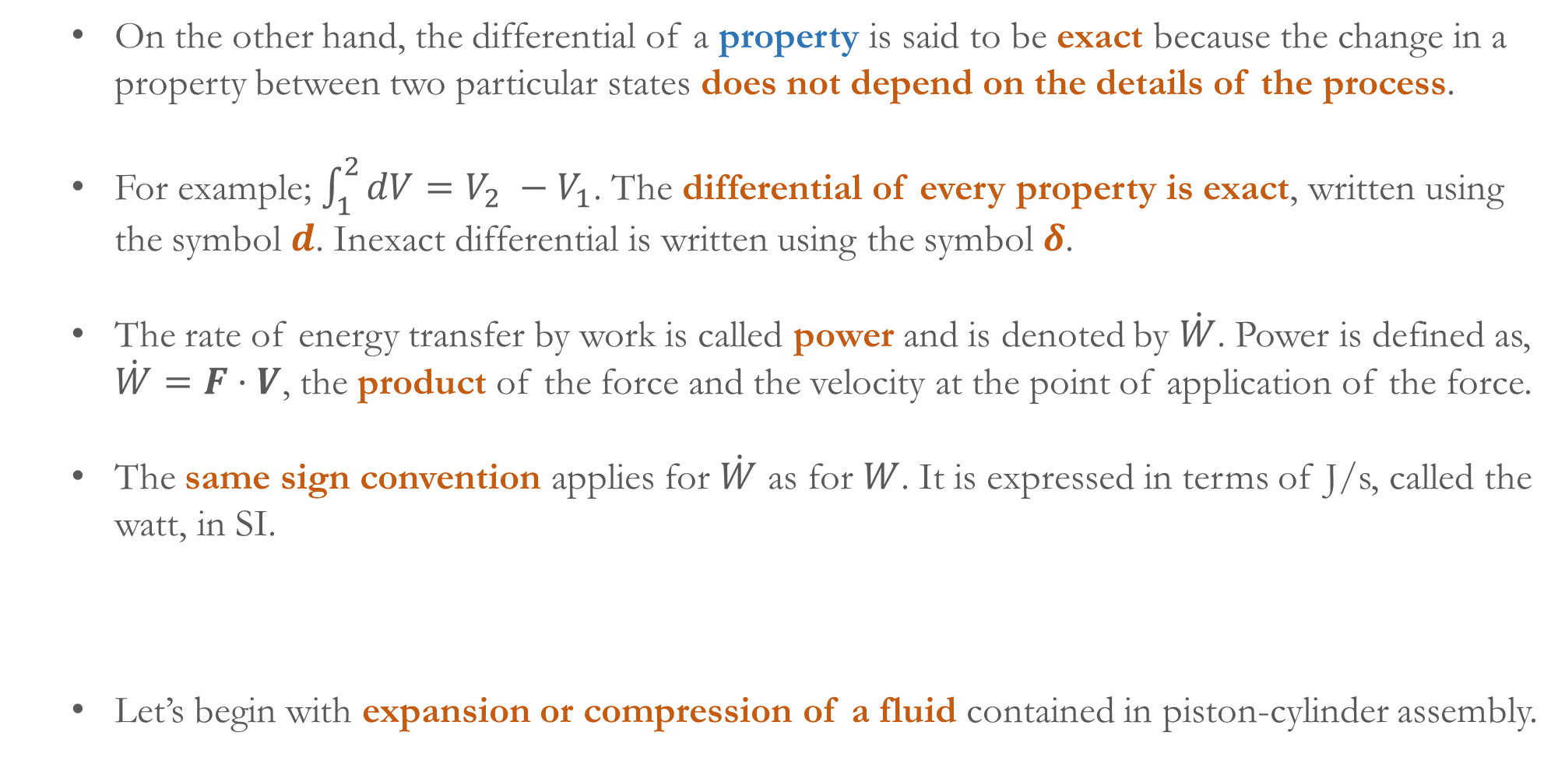
On the other hand, the differential of a property is said to be exact because the change in a property between two particular states does not depend on the details of the process.
For example; $\int_{1}^{2}{dV}=V_{2} −V_{1}$. The differential of every property is exact, written using the symbol $d$. Inexact differential is written using the symbol $δ$.
The rate of energy transfer by work is called power and is denoted by $\dot{W}$. Power is defined as, $\dot{W}=F⋅V$, the product of the force and the velocity at the point of application of the force.
The same sign convention applies for $\dot{W}$ as for $W$. It is expressed in terms of J/s, called the watt, in SI.
Let’s begin with expansion or compression of a fluid contained in piston-cylinder assembly.

Slide 3
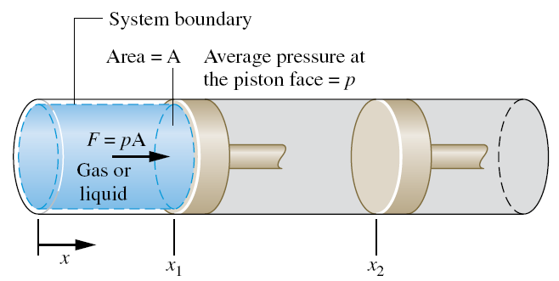
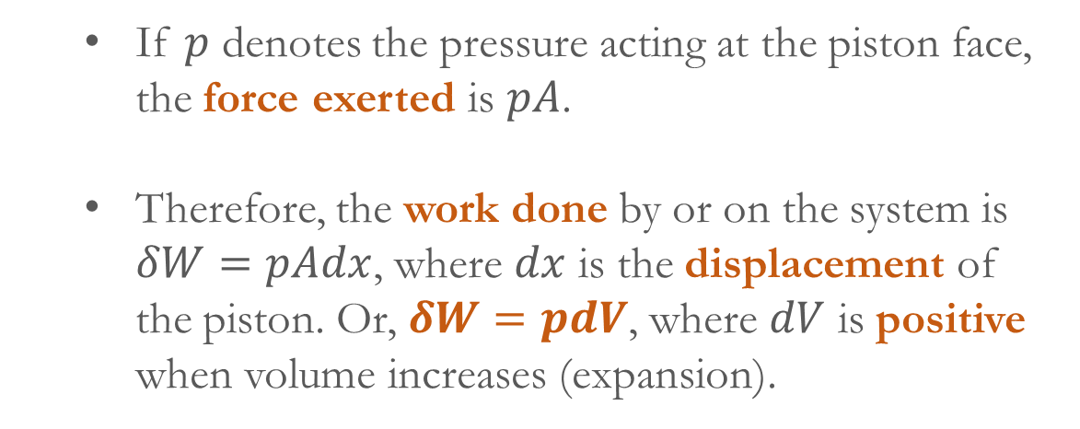
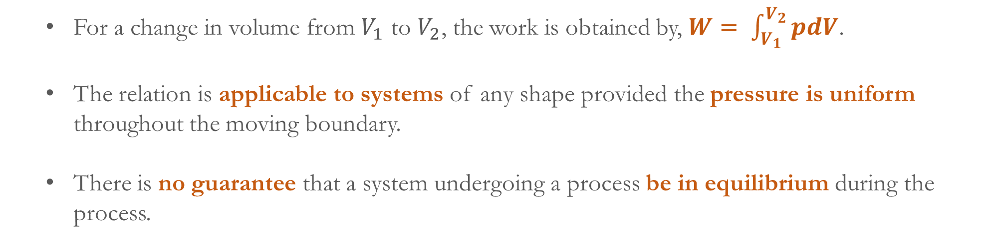
If $p$ denotes the pressure acting at the piston face, the force exerted is $pA$.
Therefore, the work done by or on the system is $δW=pAdx$, where $dx$ is the displacement of the piston. Or, $δW=pdV$, where $dV$ is positive when volume increases (expansion).
For a change in volume from $V_{1}$ to $V_{2}$, the work is obtained by, $W= \int_{V_{1}}^{V_{2}}{pdV}$.
The relation is applicable to systems of any shape provided the pressure is uniform throughout the moving boundary.
There is no guarantee that a system undergoing a process be in equilibrium during the process.

Slide 4
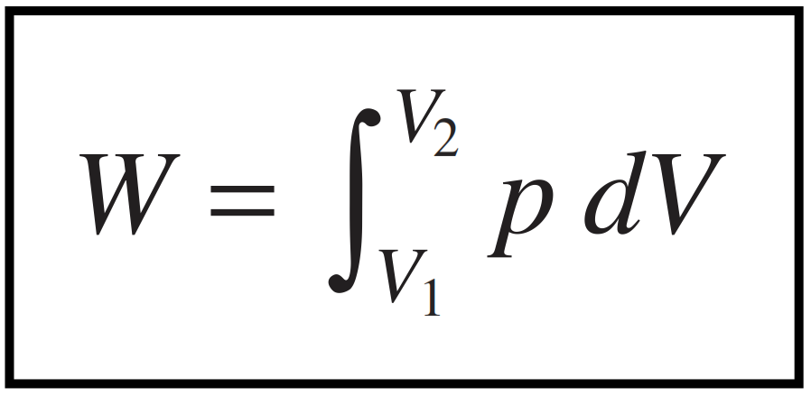
Typically, at a non-equilibrium state intensive properties vary with position at a given time. Also, at a specified position intensive properties may vary with time.
For evaluating work done, a relationship between the gas pressure at the moving boundary and the system volume is required.
However, due to non-equilibrium effects during an actual expansion or compression process, this relationship may be difficult, or even impossible, to obtain.
Here comes the concept of quasiequilibrium process.
Processes are sometime modeled as a quasiequilibrium (or quasistatic) process, an idealized process. A quasiequilibrium process is one in which the departure from thermodynamic equilibrium is infinitesimally small.

Slide 5
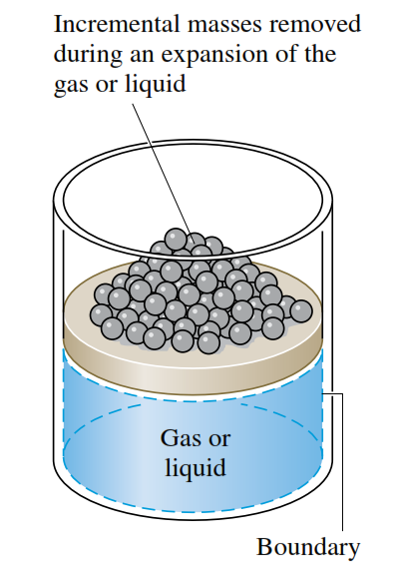
All states through which the system passes in a quasiequilibrium process may be considered equilibrium states.
Because nonequilibrium effects are inevitably present during actual processes, systems of engineering interest can at best approach, but never realize, a quasiequilibrium process.
As shown in the figure, the gas pressure is maintained uniform throughout by a number of small masses.
If one of the masses is removed, the state of the gas would depart only slightly from equilibrium.
If several of the masses were removed one after another, the gas would pass through a sequence of such equilibrium states.
In the limit, the gas would undergo a quasiequilibrium expansion process.

Slide 6
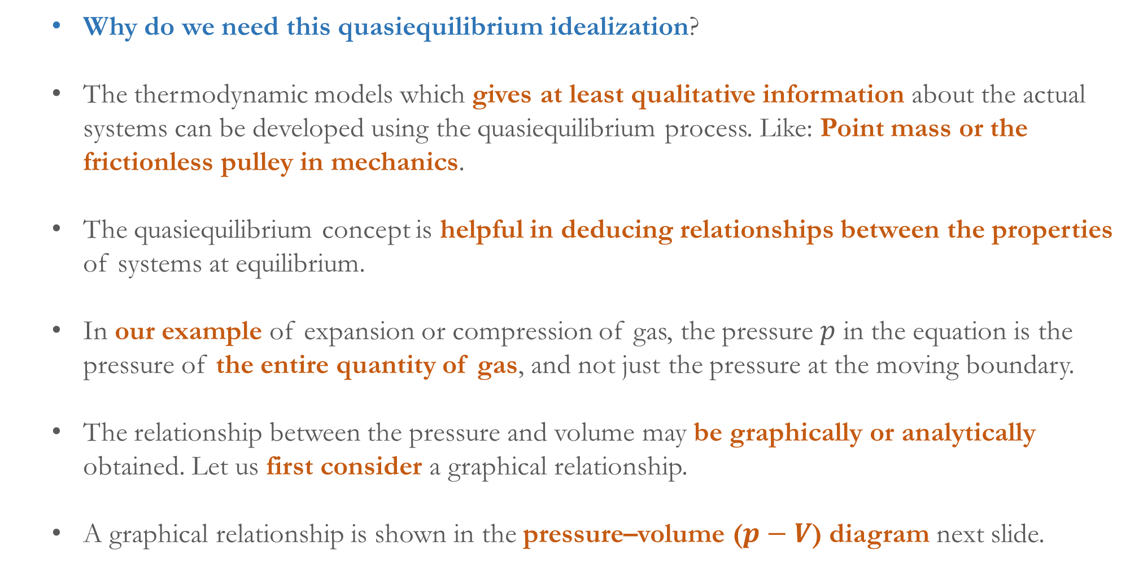
Why do we need this quasiequilibrium idealization?
The thermodynamic models which gives at least qualitative information about the actual systems can be developed using the quasiequilibrium process. Like: Point mass or the frictionless pulley in mechanics.
The quasiequilibrium concept is helpful in deducing relationships between the properties of systems at equilibrium.
In our example of expansion or compression of gas, the pressure $p$ in the equation is the pressure of the entire quantity of gas, and not just the pressure at the moving boundary.
The relationship between the pressure and volume may be graphically or analytically obtained. Let us first consider a graphical relationship.
A graphical relationship is shown in the pressure–volume ($p−V$) diagram next slide.

Slide 7
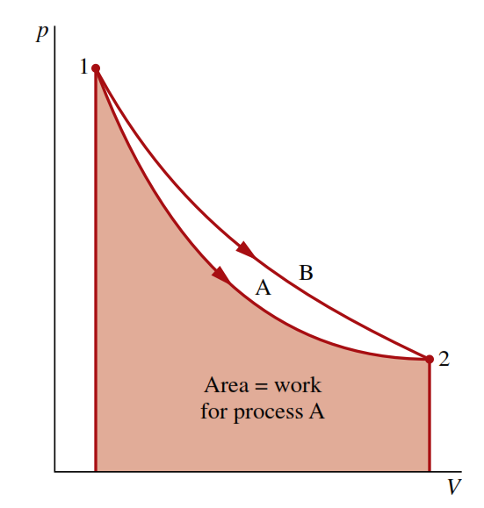
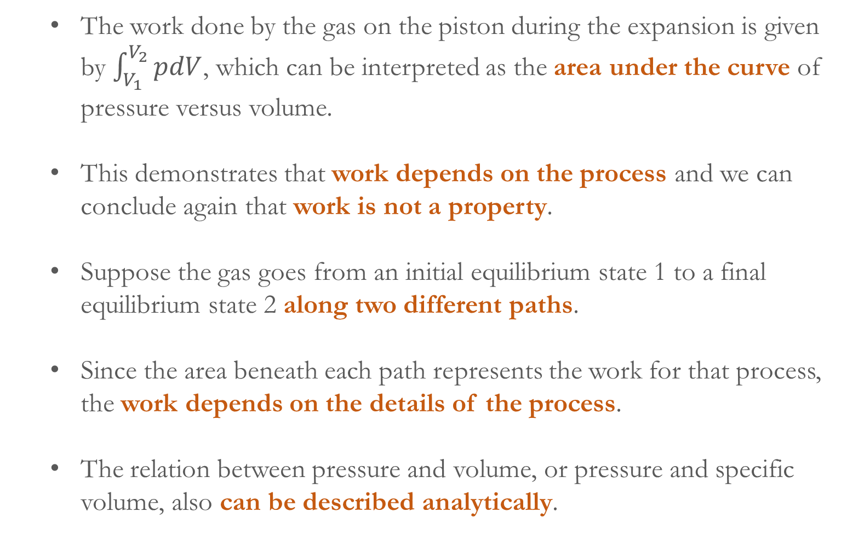
The work done by the gas on the piston during the expansion is given by $\int_{V_{1}}^{V_{2}}{pdV}$, which can be interpreted as the area under the curve of pressure versus volume.
This demonstrates that work depends on the process and we can conclude again that work is not a property.
Suppose the gas goes from an initial equilibrium state 1 to a final equilibrium state 2 along two different paths.
Since the area beneath each path represents the work for that process, the work depends on the details of the process.
The relation between pressure and volume, or pressure and specific volume, also can be described analytically.

Slide 8
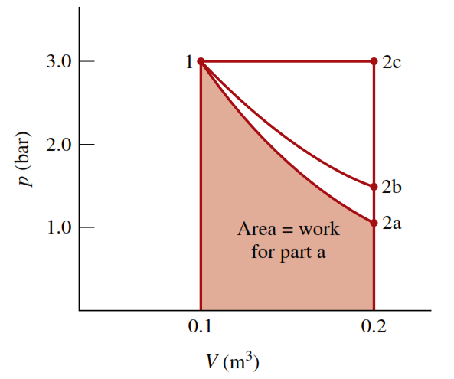
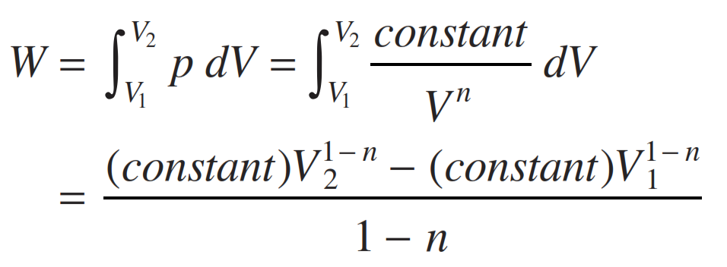
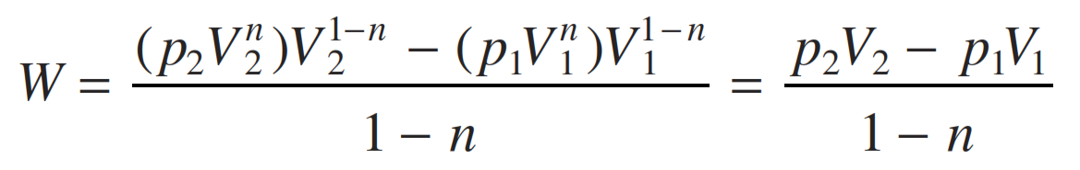
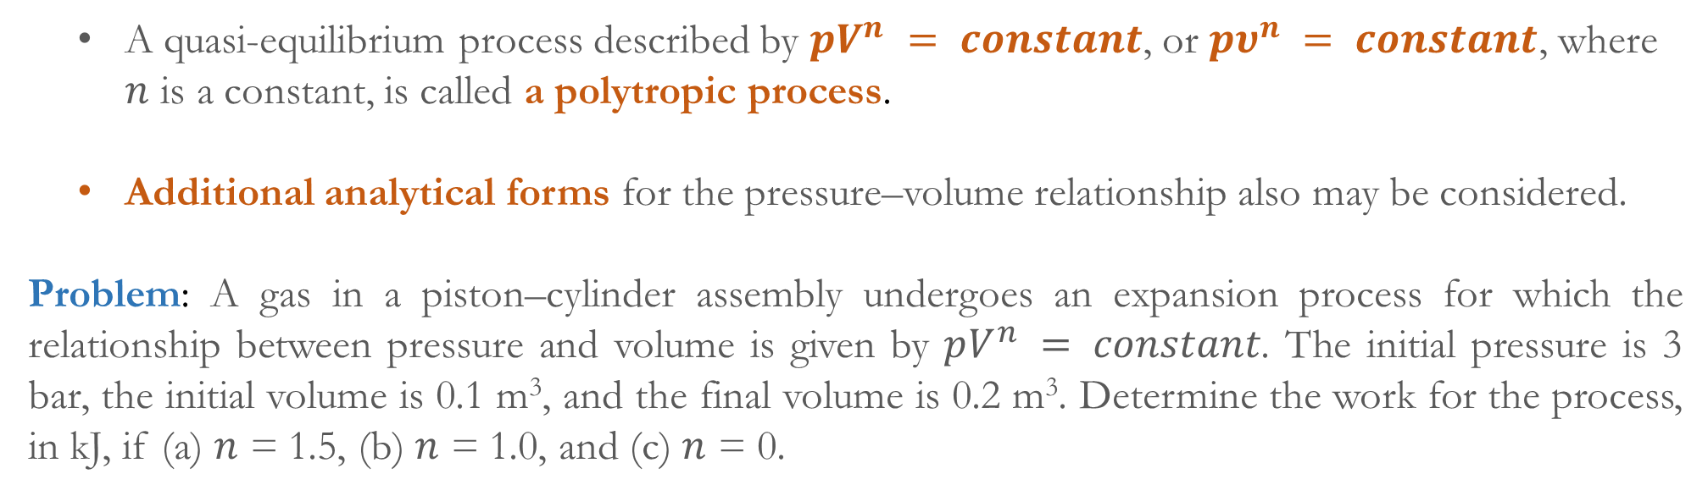
A quasi-equilibrium process described by $pV^{n} = constant$, or $pυ^{n} = constant$, where $n$ is a constant, is called a polytropic process.
Additional analytical forms for the pressure–volume relationship also may be considered.
Problem: A gas in a piston–cylinder assembly undergoes an expansion process for which the relationship between pressure and volume is given by $pV^{n} = constant$. The initial pressure is 3 bar, the initial volume is 0.1 m³, and the final volume is 0.2 m³. Determine the work for the process, in kJ, if (a) $n$ = 1.5, (b) $n$ = 1.0, and (c) $n$ = 0.

Slide 9
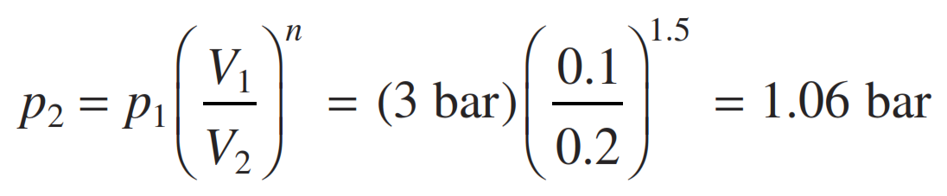
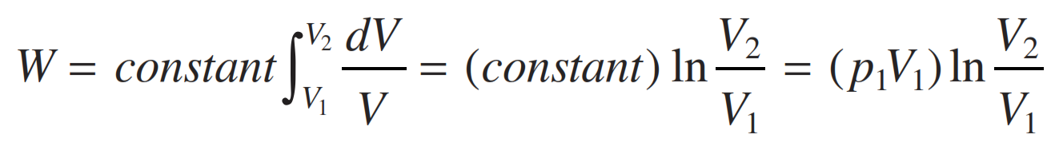
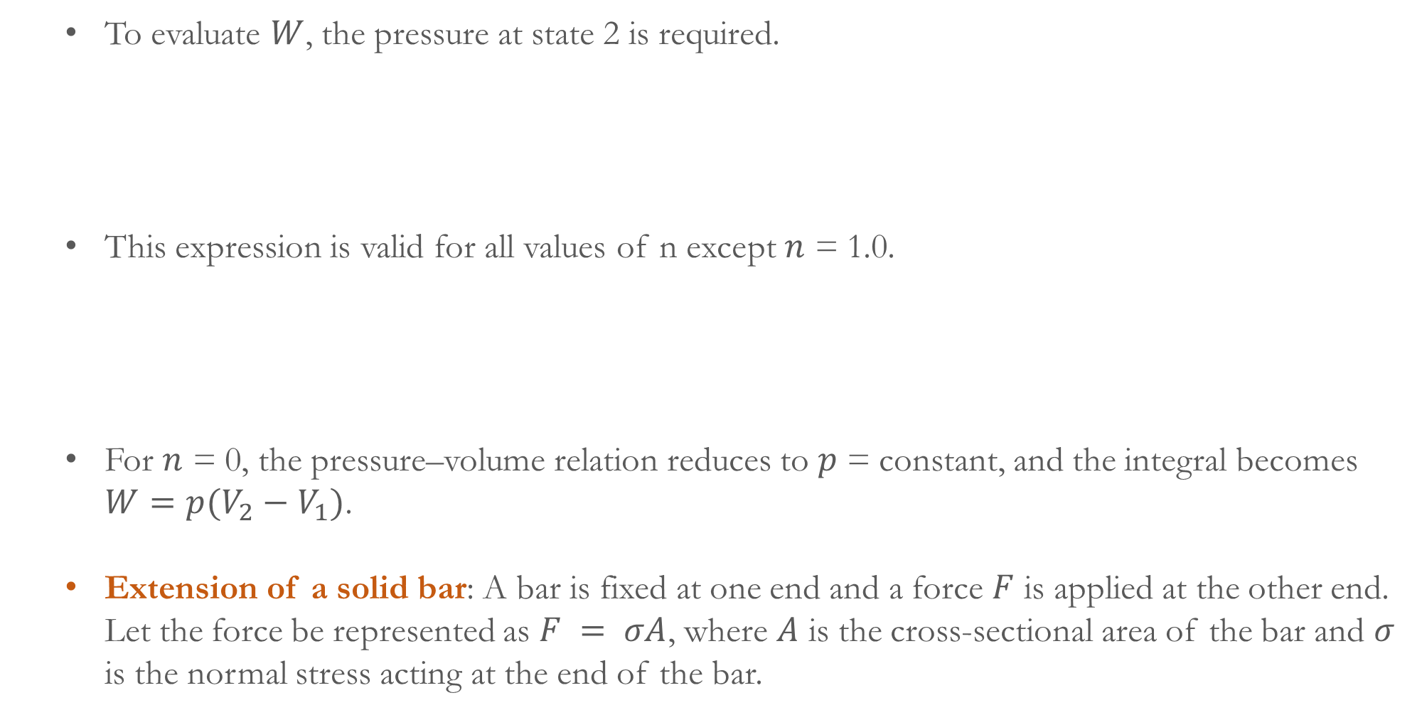
To evaluate $W$, the pressure at state 2 is required.
This expression is valid for all values of n except $n$ = 1.0.
For $n$ = 0, the pressure–volume relation reduces to $p$ = constant, and the integral becomes $W=p(V_{2}−V_{1})$.
Extension of a solid bar: A bar is fixed at one end and a force $F$ is applied at the other end. Let the force be represented as $F = σA$, where $A$ is the cross-sectional area of the bar and $σ$ is the normal stress acting at the end of the bar.

Slide 10
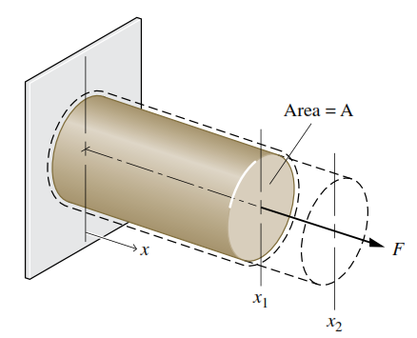
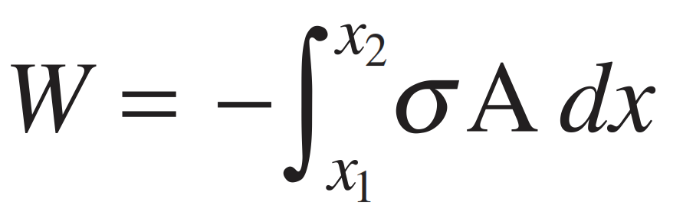
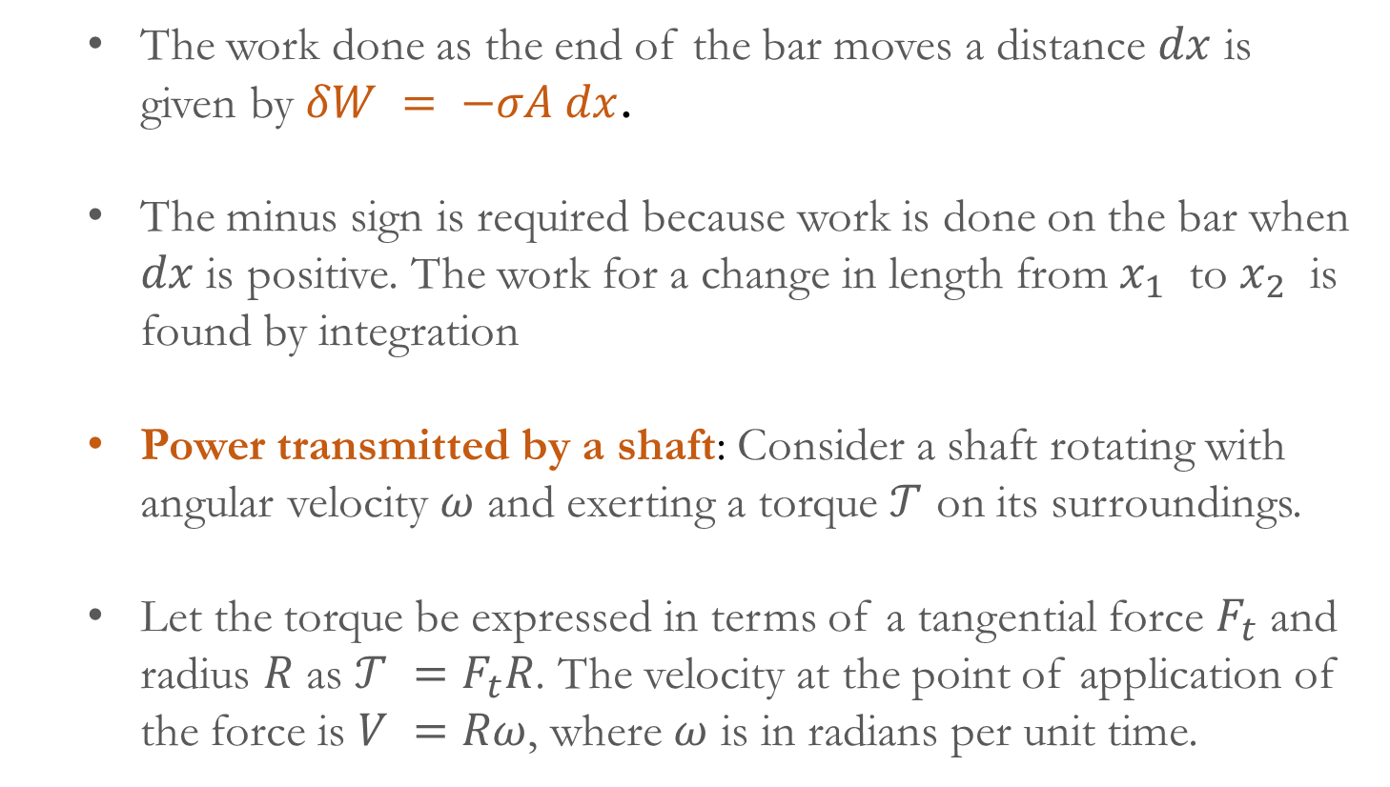
The work done as the end of the bar moves a distance $dx$ is given by $δW = −σA dx$.
The minus sign is required because work is done on the bar when $dx$ is positive. The work for a change in length from $x_{1}$ to $x_{2}$ is found by integration
Power transmitted by a shaft: Consider a shaft rotating with angular velocity $ω$ and exerting a torque $𝒯$ on its surroundings.
Let the torque be expressed in terms of a tangential force $F_{t}$ and radius $R$ as $𝒯 =F_{t}R$. The velocity at the point of application of the force is $V =Rω$, where $ω$ is in radians per unit time.
Therefore, the power transmitted from the shaft to the surroundings is: $\dot{W}=F_{t}V=\left(𝒯/R\right)\left(Rω\right)=𝒯ω$.

Slide 11
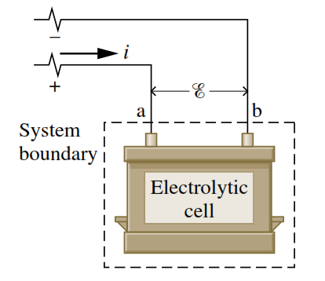
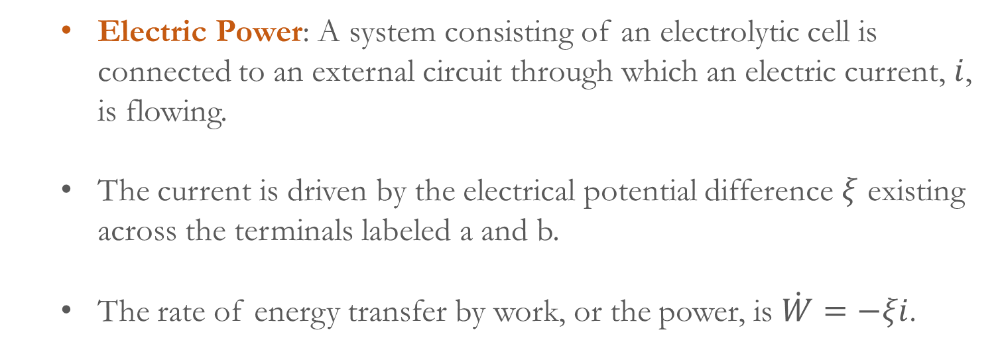
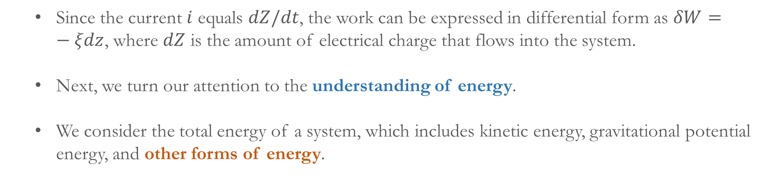
Electric Power: A system consisting of an electrolytic cell is connected to an external circuit through which an electric current, $i$, is flowing.
The current is driven by the electrical potential difference $ξ$ existing across the terminals labeled a and b.
The rate of energy transfer by work, or the power, is $\dot{W}=−ξi$.
Since the current $i$ equals $dZ/dt$, the work can be expressed in differential form as $δW=−ξdz$, where $dZ$ is the amount of electrical charge that flows into the system.
Next, we turn our attention to the understanding of energy.
We consider the total energy of a system, which includes kinetic energy, gravitational potential energy, and other forms of energy.

Slide 12
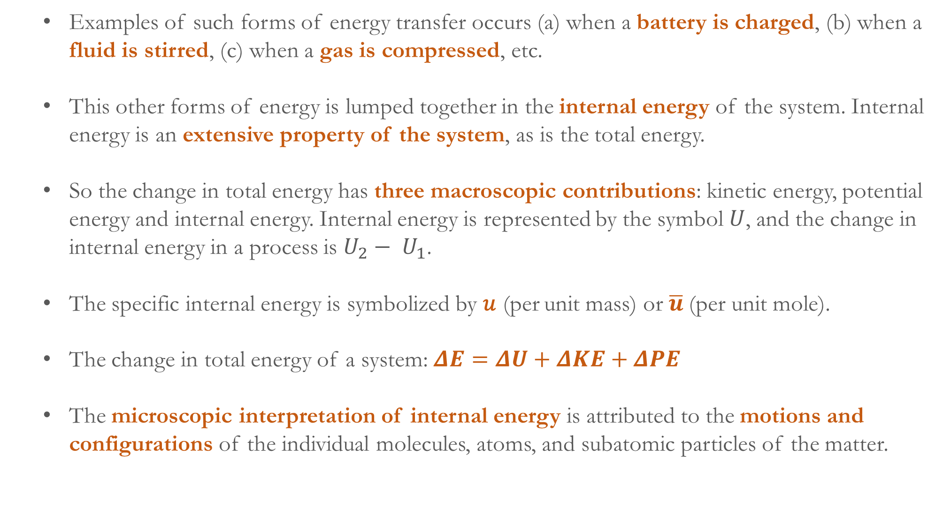
Examples of such forms of energy transfer occurs (a) when a battery is charged, (b) when a fluid is stirred, (c) when a gas is compressed, etc.
This other forms of energy is lumped together in the internal energy of the system. Internal energy is an extensive property of the system, as is the total energy.
So the change in total energy has three macroscopic contributions: kinetic energy, potential energy and internal energy. Internal energy is represented by the symbol $U$, and the change in internal energy in a process is $U_{2}− U_{1}$.
The specific internal energy is symbolized by 𝑢 (per unit mass) or $\overline{u}$(per unit mole).
The change in total energy of a system: $ΔE=ΔU+ΔKE+ΔPE$
The microscopic interpretation of internal energy is attributed to the motions and configurations of the individual molecules, atoms, and subatomic particles of the matter.

Slide 13
Energy attributed to the kinetic energy (rotational, vibrational and translational) of the molecules is know as thermal energy.
Energy stored in the chemical bonds between the atoms that make up the molecules is known as chemical energy.
Energy stored in nucleus is know as nuclear energy.
Therefore, internal energy can be broadly categorized into thermal, chemical and nuclear energy.
So far, we discussed the energy transfer by work. We now move our attention to energy transfer by heat.

Slide 14
The symbol $Q$ denotes an amount of energy transferred in a heat interaction between system and surroundings.
If a system undergoes a process involving no heat transfer with its surroundings, that process is called an adiabatic process.
Heat transfer into a system is taken to be positive ($Q>0$), and heat transfer from a system is taken as negative ($Q<0$). The sign convention for heat transfer is just the reverse of the one adopted for work.
The value of a heat transfer depends on the details of a process and not just the end states. Thus, like work, heat is not a property.
Therefore, the differential of heat transferred is written as $δQ$. The amount of energy transfer by heat for a process is given by the integral, $Q= \int_{1}^{2}{δQ}$ (from state 1 to state 2).

Slide 15
The net rate of heat transfer is denoted by $\dot{Q}$. In some cases it is convenient to use the heat flux, $\dot{q}$, which is the heat transfer rate per unit of surface area.
The units for heat transfer $Q$ and heat transfer rate $\dot{Q}$ are J and J/s or W, respectively. The unit for the heat flux is W/m² or kW/m².
Based on the experimental evidence, three mechanisms of heat transfer are recognized: Conduction, Convection and Radiation.
Conduction: Transfer of energy occurs from the more energetic particles of a substance to adjacent particles that are less energetic due to interactions between particles, governed by Fourier’s law.
By Fourier’s law, the rate of heat transfer across any plane normal to the $x$ direction, ${\dot{Q}}_{x}$, is proportional to the wall area, $A$, and the temperature gradient in the $x$ direction, $dT/dx$ as,

Slide 16
${\dot{Q}}_{x}=−κA\frac{dT}{dx}$
where the proportionality constant $κ$ is a property called the thermal conductivity. The minus sign is a consequence of energy transfer in the direction of decreasing temperature.
Convection: Energy transfer occurs between a surface (solid or fluid, real or imaginary) at a temperature $T_{b}$ and an adjacent gas or liquid at another temperature $T_{f}$ by the mode of convection.
Energy is transferred due to the combined effects of conduction within the fluid and the bulk motion of the fluid.
The rate of energy transfer between the surface and the fluid can be quantified by the an empirical expression, ${\dot{Q}}_{c}=hA({|T}_{b}−T_{f}|)$, known as Newton’s law of cooling.

Slide 17
$A$ is the surface area and the proportionality factor $h$ (not a thermodynamic property) is called the heat transfer coefficient.
Radiation: Thermal radiation is emitted by matter as a result of changes in the electronic configurations of the atoms or molecules within it.
The energy is transported by electromagnetic waves (or photons). Unlike conduction and convection, thermal radiation requires no intervening medium to propagate and can even take place in a vacuum.
The rate at which energy is emitted, ${\dot{Q}}_{e}$, from a surface of area $A$ of temperature $T_{b}$ is quantified macroscopically by a modified form of the Stefan–Boltzmann law as, ${\dot{Q}}_{e}=εσAT_{b}^{4}$.
The emissivity, $ε$ indicates how effectively the surface radiates ($0 ≤ ε ≤ 1.0$), and $σ$ is the Stefan–Boltzmann constant, $σ=5.67×{10}^{−8}W/m^{2}⋅K^{4}$.

Slide 18
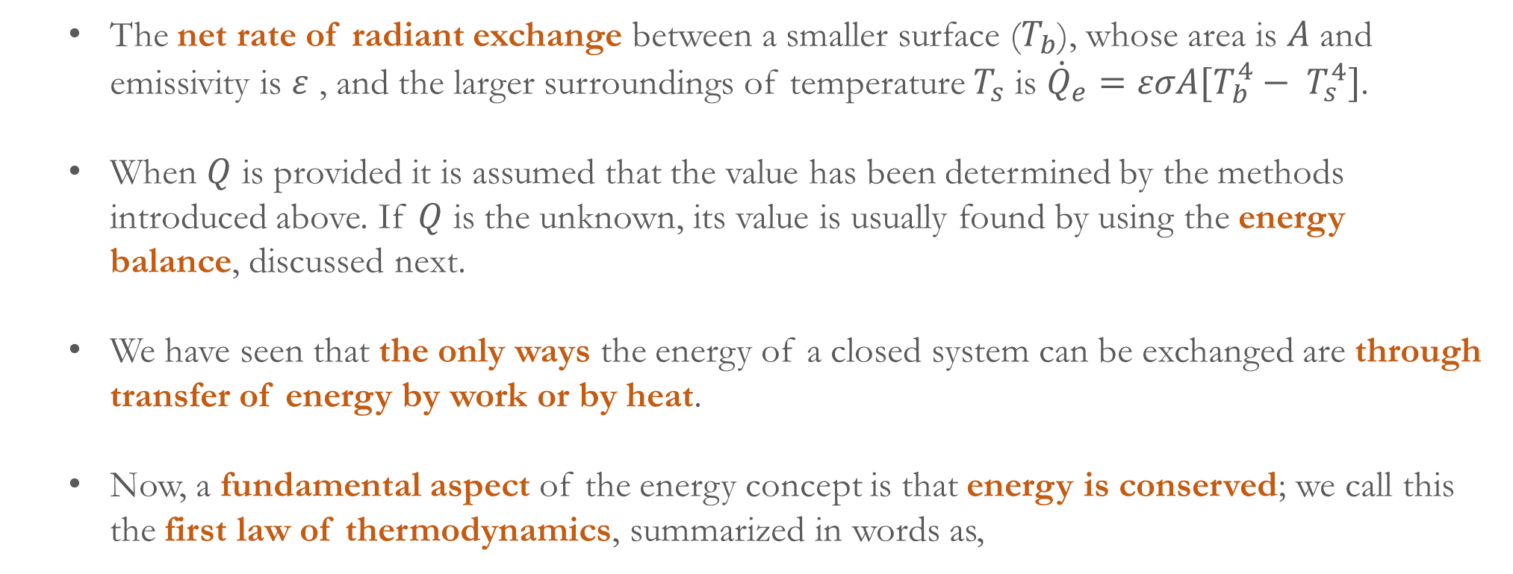
The net rate of radiant exchange between a smaller surface ($T_{b}$), whose area is $A$ and emissivity is $ε$ , and the larger surroundings of temperature $T_{s}$ is ${\dot{Q}}_{e}=εσA[T_{b}^{4}− T_{s}^{4}]$.
When $Q$ is provided it is assumed that the value has been determined by the methods introduced above. If $Q$ is the unknown, its value is usually found by using the energy balance, discussed next.
We have seen that the only ways the energy of a closed system can be exchanged are through transfer of energy by work or by heat.
Now, a fundamental aspect of the energy concept is that energy is conserved; we call this the first law of thermodynamics, summarized in words as,
$$\left[\begin{aligned}Change in the amount \\ of energy contained \\ within a system during \\ some time interval\end{aligned}\right]=\left[\begin{aligned}\begin{aligned}Net amount of energy \\ transferred in across the\end{aligned} \\ system boundary by heat \\ transfer during the time interval\end{aligned}\right]+\left[\begin{aligned}Net amout of energy \\ transferred out accorss the \\ system boundary by work \\ during the time interval\end{aligned}\right]$$

